Slide 1
SKKU Lab Recommendation Service : FindMyLab
Weekly Progress Meeting(1)
Team J (Last Lap) 김현진 송민석 장민석 조재희
2024-Fall Capstone Design Project

Slide 2
Contents
1
2
3
4
5
6
Abstract Extractor
Back-End
AI-related
Content
Recommendation
Algorithm
Algorithm
Evaluation
Next short-term Goal
2024-Fall Capstone Design Project
Team J (Last Lap) 김현진 송민석 장민석 조재희

Slide 3








Topic Overview
AI
Natural Language Lab
Machine Learning Lab
PhD Kim
#NLP #AI #ComputerVision
Recent Paper: How to get information from …
PhD Song
#ML #Unity #SmartFactory
Recent Paper: How to use machine Learning …
Computer Graphics Lab
Security Lab
PhD Jo
#ML #Visualization #ComputerVision
Recent Paper: How to improve graphics by using AI …
PhD Lee
#Security #AI #SoftwareEngineering
Recent Paper: How to detect virus by AI…
2024-Fall Capstone Design Project
Team J (Last Lap) 김현진 송민석 장민석 조재희

Slide 4
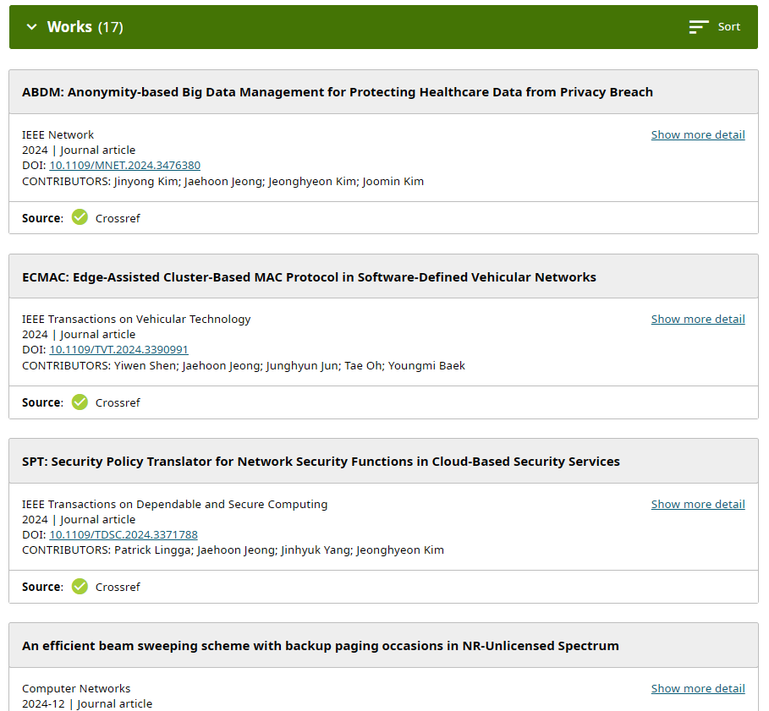

1. Abstract Extractor
2024-Fall Capstone Design Project
Team J (Last Lap) 김현진 송민석 장민석 조재희

Slide 5
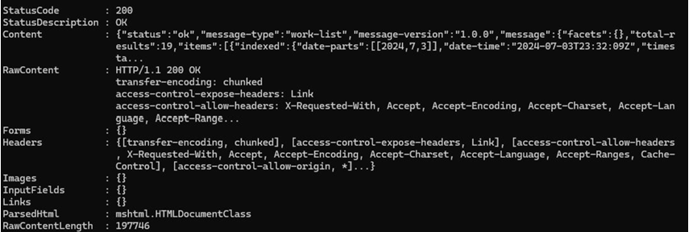
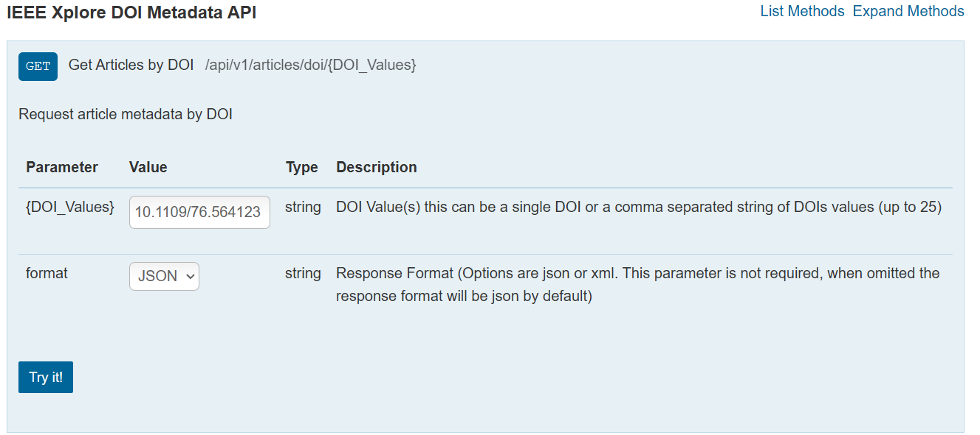
1. Abstract Extractor
[CrossRef API]
Get Work List by ORCID
[IEEE API]
Extract Abstract by DOI
2024-Fall Capstone Design Project
Team J (Last Lap) 김현진 송민석 장민석 조재희

Slide 6
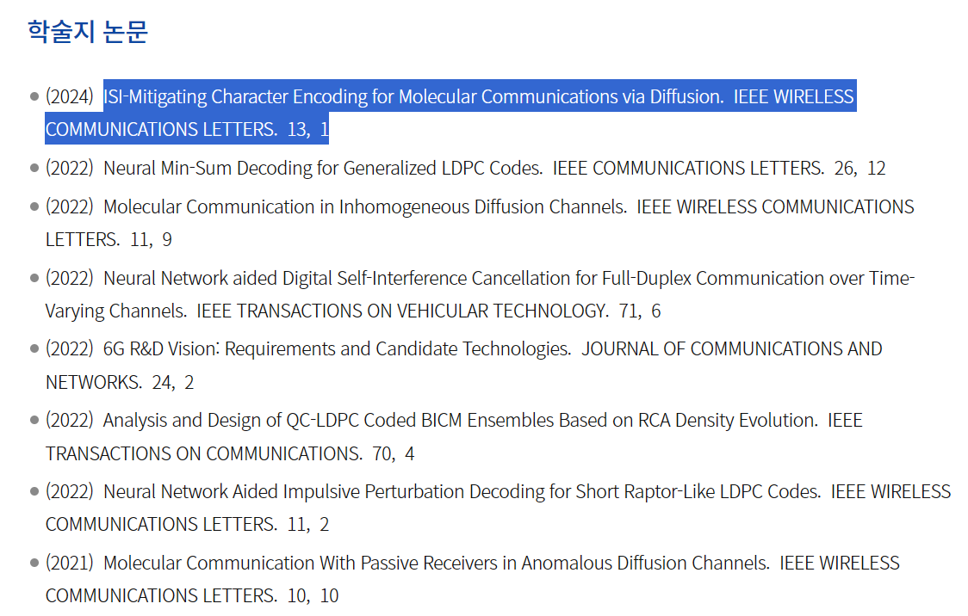
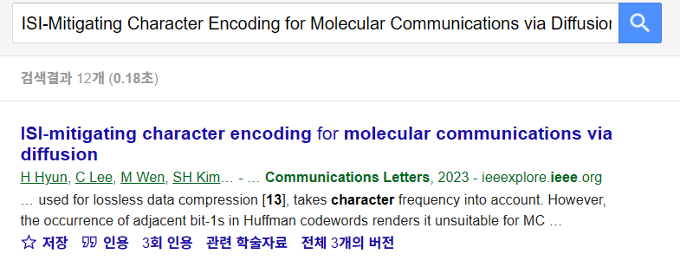
1. Abstract Extractor
[SKKU EEE Faculty Page]
https://ice.skku.edu/eng_ice/intro/faculty_elec.do
[Google Scholar]
2024-Fall Capstone Design Project
Team J (Last Lap) 김현진 송민석 장민석 조재희

Slide 7
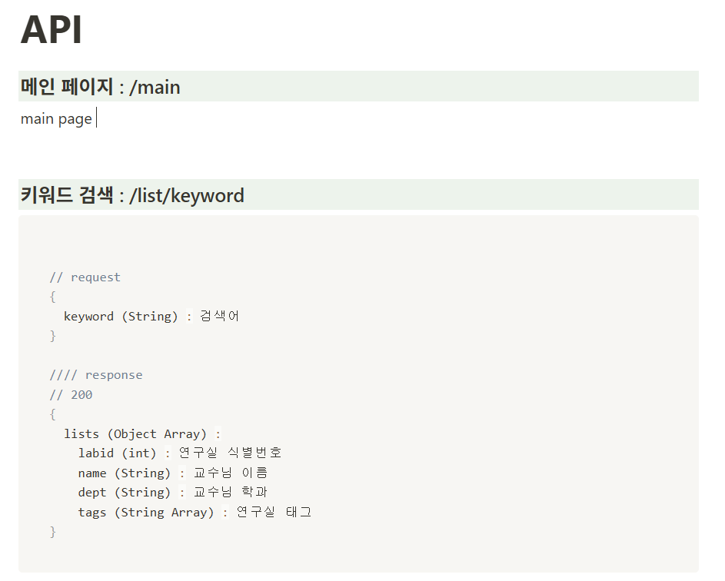
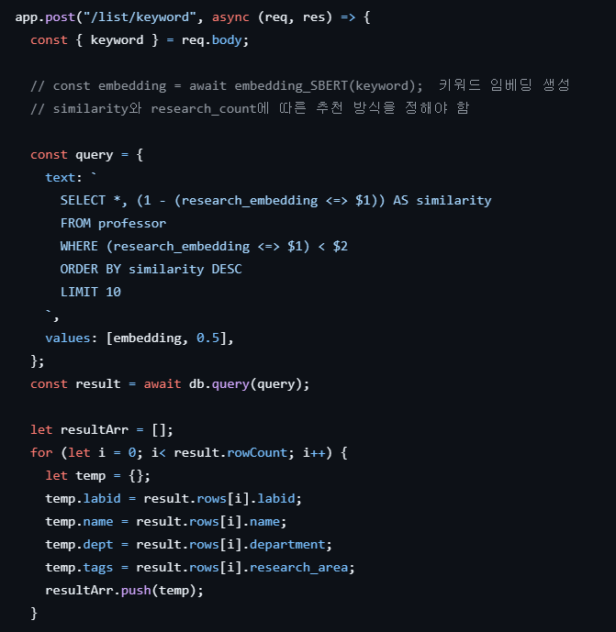
2. Back-End
API Document
Prototype Server
2024-Fall Capstone Design Project
Team J (Last Lap) 김현진 송민석 장민석 조재희
Notes:
서버 프로토 타입

Slide 8
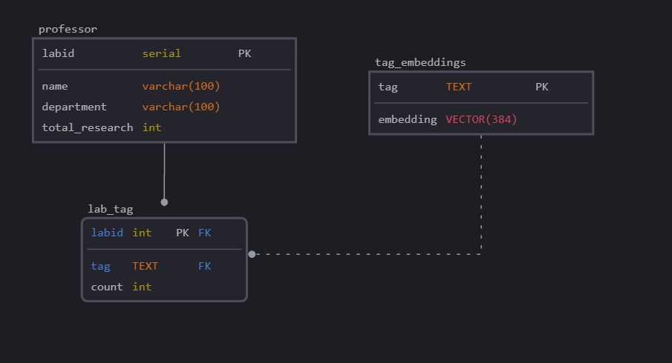
2. Back-End
2024-Fall Capstone Design Project
Team J (Last Lap) 김현진 송민석 장민석 조재희

Slide 9
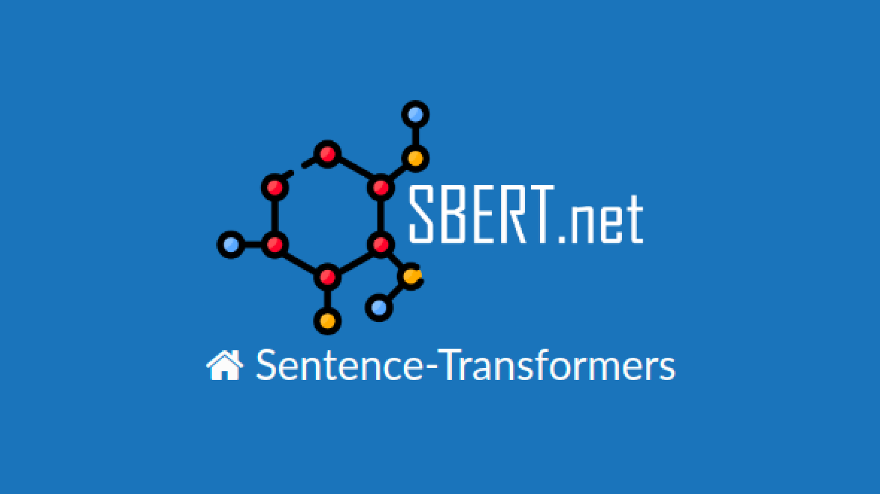
3. AI-related Content
2024-Fall Capstone Design Project
Team J (Last Lap) 김현진 송민석 장민석 조재희

Slide 10

3. AI-related Content
Key Words
Machine Learning, Block Chain, etc …
2024-Fall Capstone Design Project
Team J (Last Lap) 김현진 송민석 장민석 조재희

Slide 11
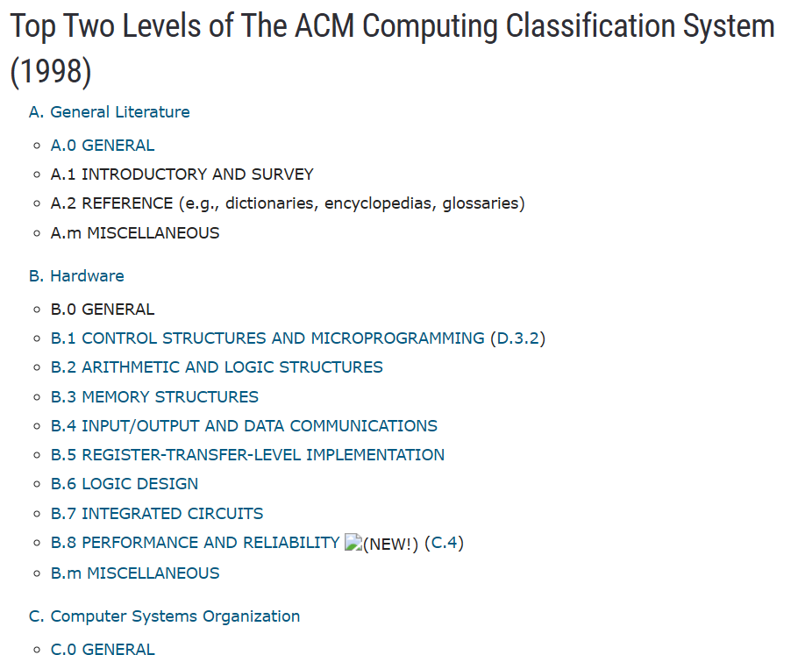

3. AI-related Content
2024-Fall Capstone Design Project
Team J (Last Lap) 김현진 송민석 장민석 조재희

Slide 12

4. Recommendation Algorithm
Keyword Frequency
Embedding
[Database]
2024-Fall Capstone Design Project
Team J (Last Lap) 김현진 송민석 장민석 조재희

Slide 13
4. Recommendation Algorithm
Use All Keyword
Use Keyword : Cosine Similarity > K
Frequency X Cosine Similarity
Frequency of Keyword
Professor A | Cosine Similarity | Frequency
Machine Learning | 0.95 | 0.8
Security | 0.5 | 0.7
Professor A | Cosine Similarity | Frequency
Machine Learning | 0.95 | 0.8
Security | 0.5 | 0.7
Weight : 0.95 X 0.8 + 0.5 X 0.7
Weight : 0.8 (ML’s Frequency)
2024-Fall Capstone Design Project
Team J (Last Lap) 김현진 송민석 장민석 조재희

Slide 14
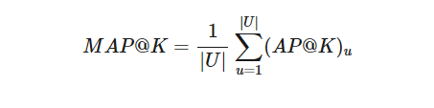
5. Algorithm Evaluation
2024-Fall Capstone Design Project
Team J (Last Lap) 김현진 송민석 장민석 조재희

Slide 15


6. Next Step
2024-Fall Capstone Design Project
Team J (Last Lap) 김현진 송민석 장민석 조재희

Slide 16
Q & A
2024-Fall Capstone Design Project
Team J (Last Lap) 김현진 송민석 장민석 조재희

